Slide 1

Differentiable Programming for Modeling and Control of Dynamical Systems
Ján Drgoňa
Aaron Tuor
Shrirang Abhyankar
Ethan King
Andrew August
Mia Skomski
James Koch
Zhao Chen
Soumya Vasisht
Sayak Mukherjee
Mahantesh Halappanavar
Draguna Vrabie
PNNL-SA-#####
Notes:
Image: Visualization of one years of Grid operation data with Gephi Graph Analytics

Slide 2
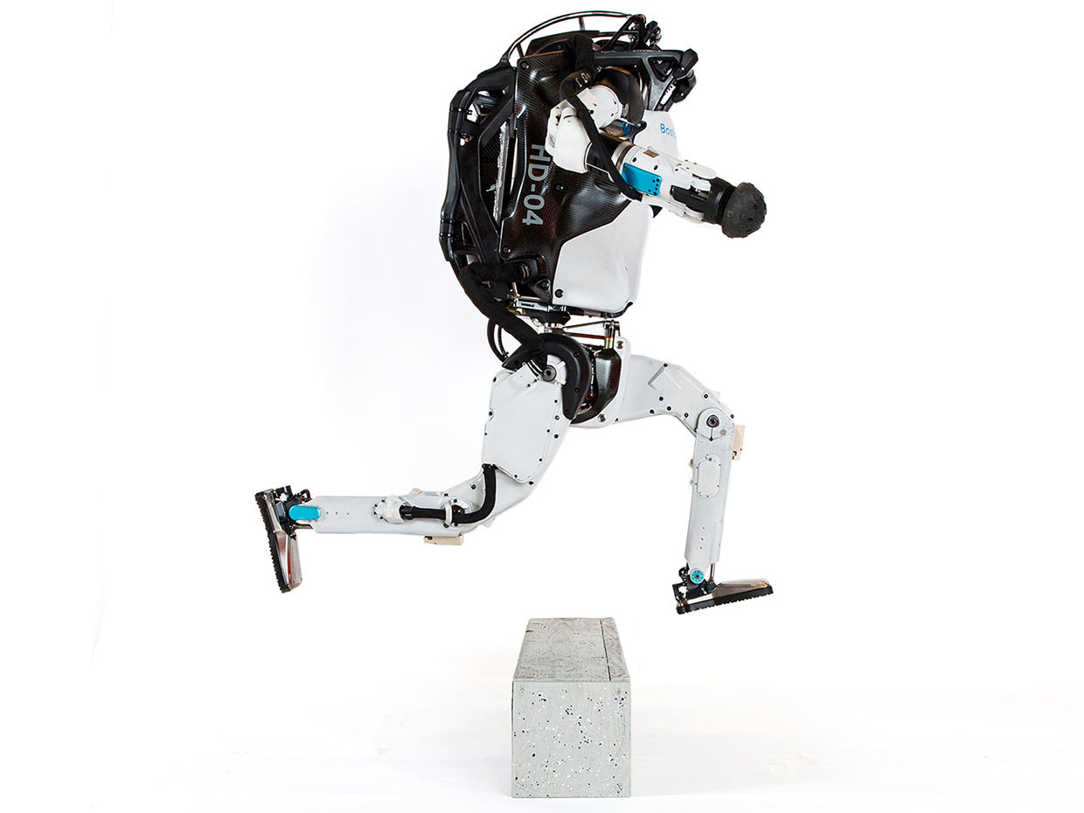


Model Predictive Control
Successes
Challenges
95% of the industrial control applications are PID loops & expert driven rule-based control (RBC).
The rest is model predictive control (MPC).
Modeling
Unknown or partially known dynamics
Physics-based modeling is expensive
Purely data-driven models lack generalization
Real-time optimization
Scalability
Computational limitations of control hardware
Parallelization, distributed optimization
Assumption:
Reliable and accurate system dynamics model
Drgona J., J. Arroyo, I.C. Figueroa, D. Blum, K. Arendt, D. Kim, and E.P. Olle, J. Oravec, M. Wetter, D. L. Vrabie, L. Helsen. 2020. "All You Need to Know About Model Predictive Control for Buildings." Annual Reviews in Control, September 29, 2020
2

Slide 3
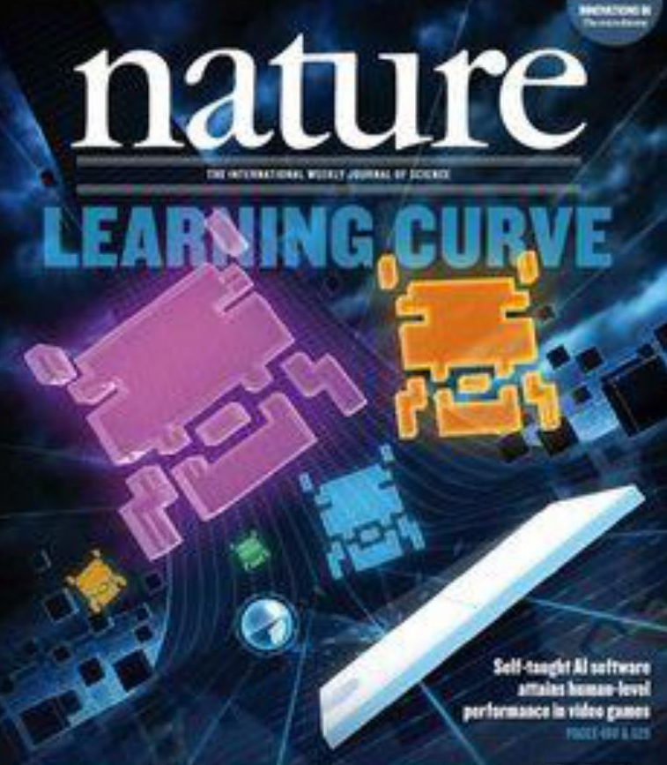

Deep Reinforcement Learning
Challenges
Successes
Everywhere where you are dealing with constraints, and stability guarantees. Learning on real system with low data and low compute regimes. Offline learning. High-dimensional continuous state and action systems. Partial observability, time delays. Task generalization and intrinsic rewards.
Everywhere where you have reliable environment model, mostly discrete action space, and you can use massive compute to solve the problem.
G. Dulac-Arnold, D. J. Mankowitz, and T. Hester, “Challenges of real-world reinforcement learning,”, 2019.
http://arxiv.org/abs/1904.12901

Slide 4
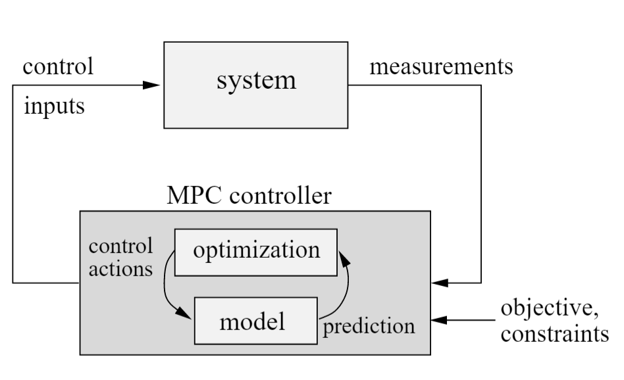
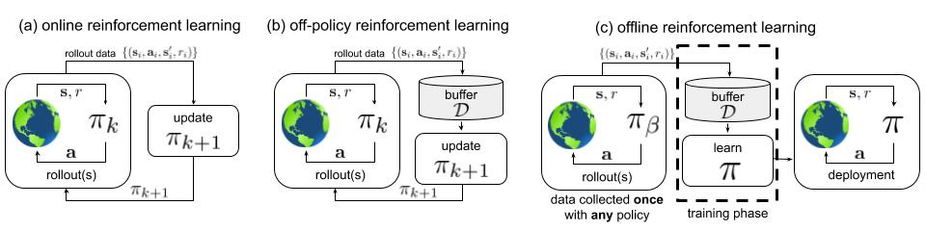
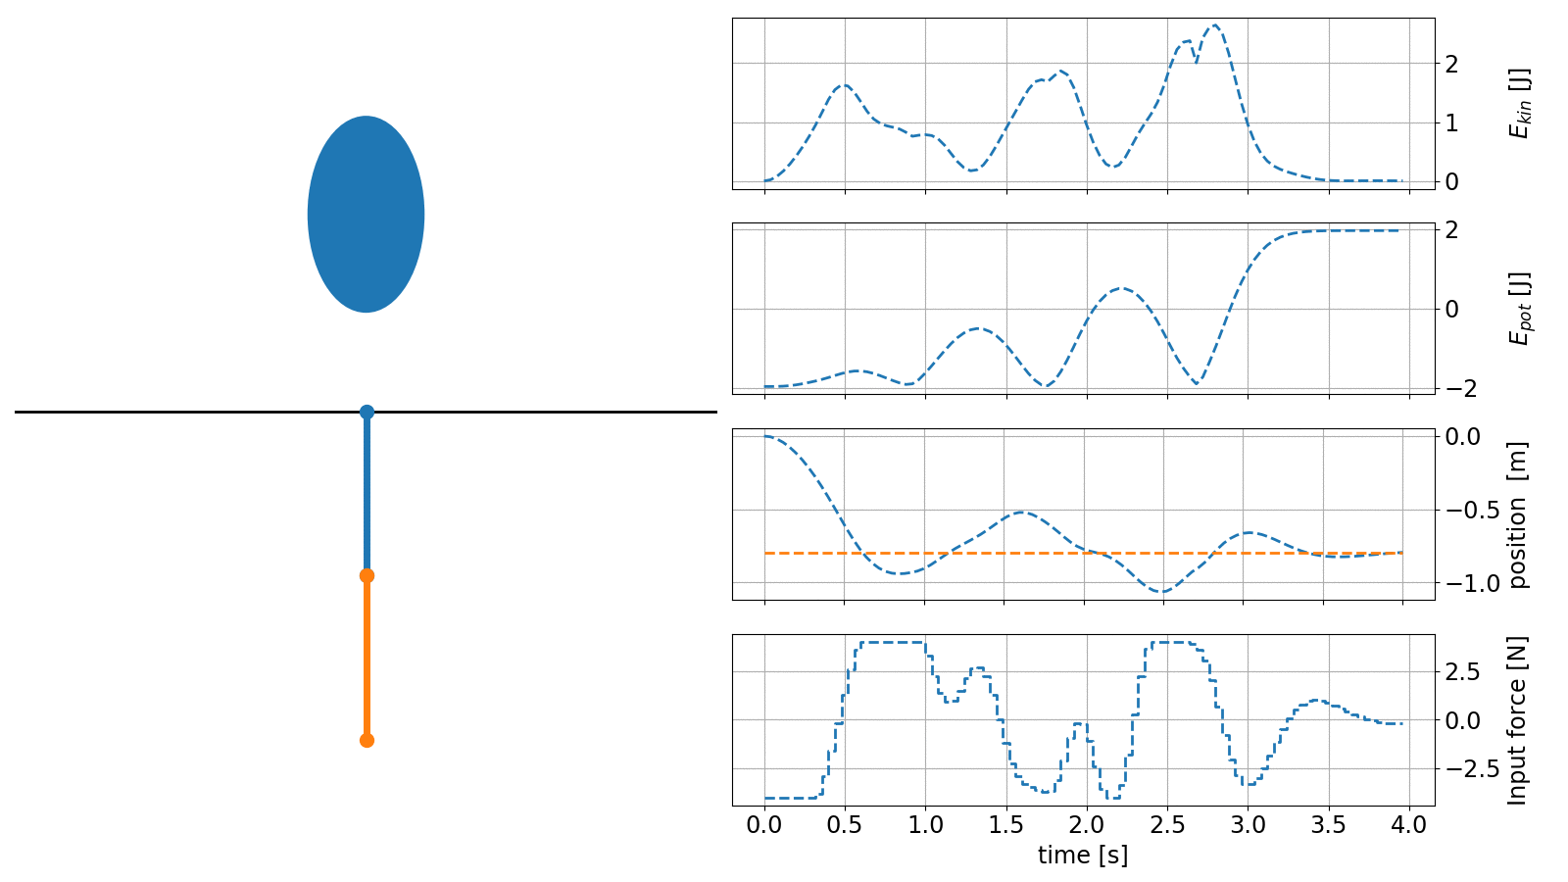
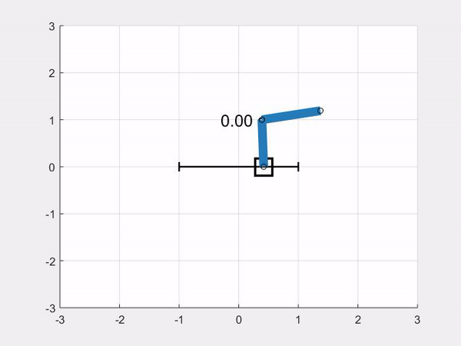
MPC vs RL
https://arxiv.org/abs/2005.01643
https://www.do-mpc.com/en/latest/
https://openocl.github.io/
MPC - Requires system model
RL - Requires system environment
MPC – parametrized value functions
RL – unknown value functions
MPC – solves constrained optimization via solvers
RL – solves unconstrained optimization via backprop and gradient descent
MPC – implicit policy
RL – explicit neural policy
https://www.argmin.net/2020/06/29/tour-revisited/

Slide 5
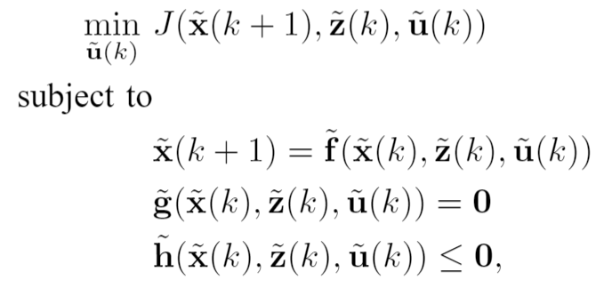
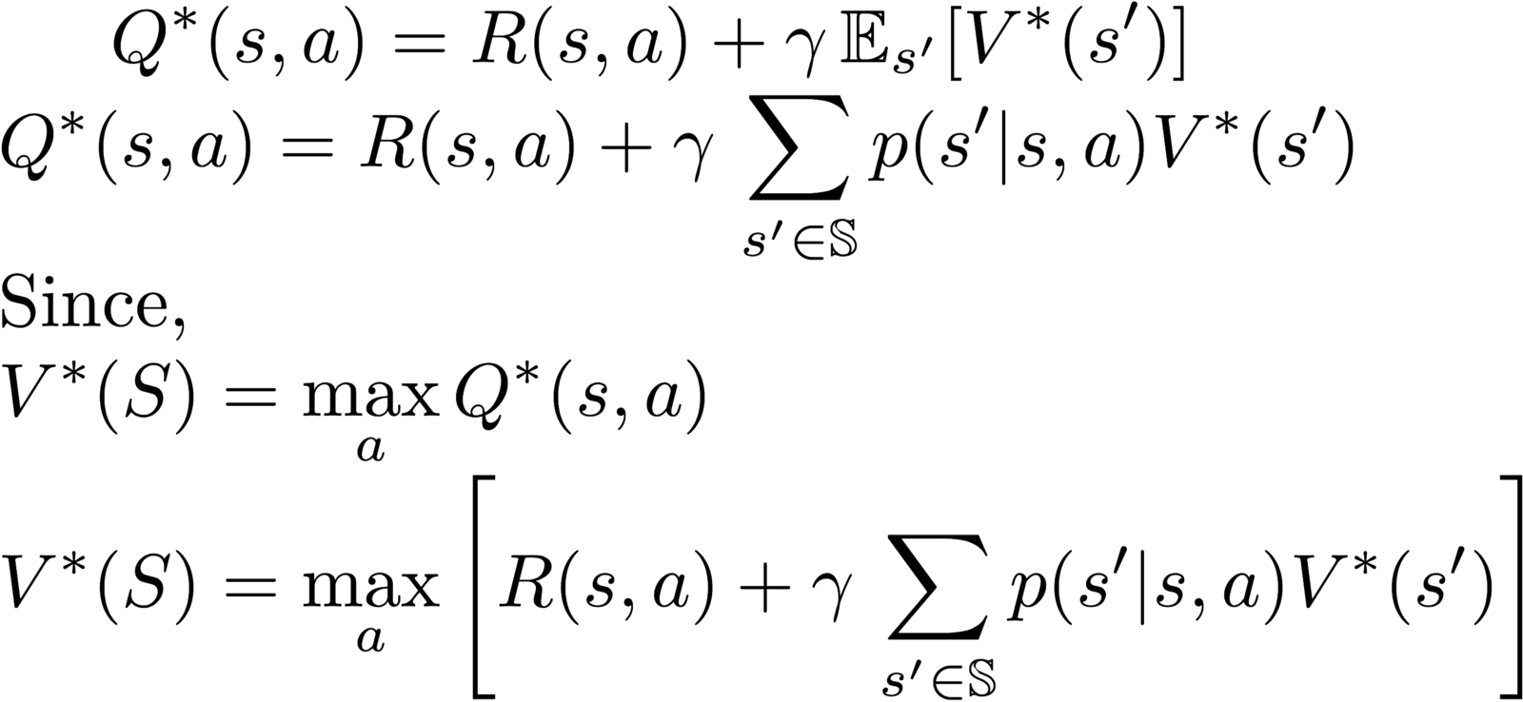
MPC vs RL
https://arxiv.org/abs/2005.01643
https://www.argmin.net/2020/06/29/tour-revisited/

Slide 6
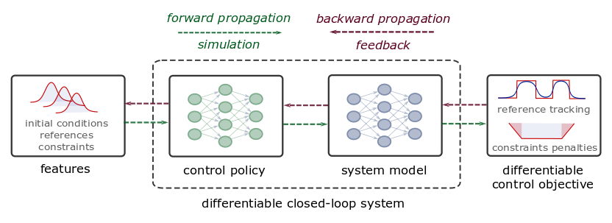
Differentiable Predictive Control
From data to explicit constrained control policy via differentiable optimization
Theoretical connection with MPC
Neural dynamical system models
Differentiable closed-loop model
Model-based policy optimization
Notes:
The conceptual methodology of DPC is illustrated here.
Assuming time series dataset obtained from the measurements of the system dynamics, in the first step, we perform system identification using a neural state-space model (SSM).
In the second step, we close the loop by combining the neural SSM with neural control law obtaining a differentiable closed-loop dynamics model fully parametrized by neural networks.
This allows us to leverage standard tools in deep learning to optimize the neural control laws by backpropagating the MPC loss function through the closed-loop dynamics.
Essentially this is a data-driven solution to multiparametric programming problems emerging from explicit nonlinear MPC.
Contrary to approximate MPC (aka imitation learning), DPC does not require supervision by an expert controller. Instead, a dynamics model is learned from a small dataset of system measurements, and the control law is then optimized offline by differentiating the learned system model.

Slide 7

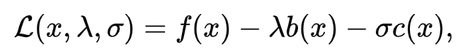
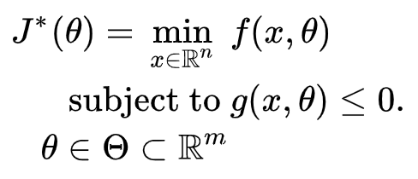

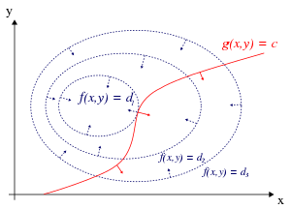
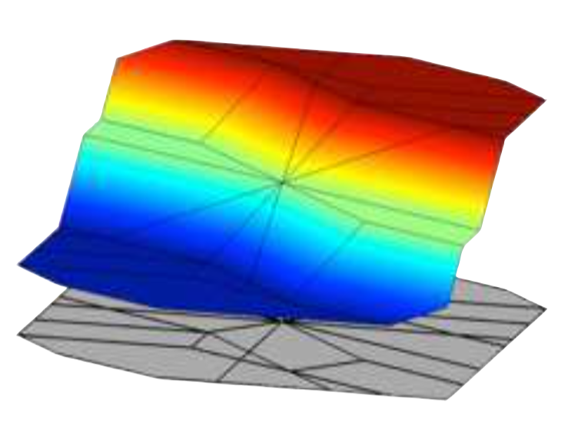


Differentiable Optimization as Lingua Franca for Scientific Computing
Standard form
Lagrangian form
Parametric programming
Machine learning
“online” optimization
single solution for
given parameter values
“online” optimization
using soft constraints
instead of hard constraints
“offline” optimization
obtains a solution map
for a set of parameters classical methods lead to
exponential complexity!
“offline” optimization
obtains a model (map)
for a set of datapoints
scalable but classically
can’t handle constraints
Differentiable parametric programming (DPP): a unifying approach for data-driven parametric programming problems with solutions based on automatic differentiation (AD)

Slide 8
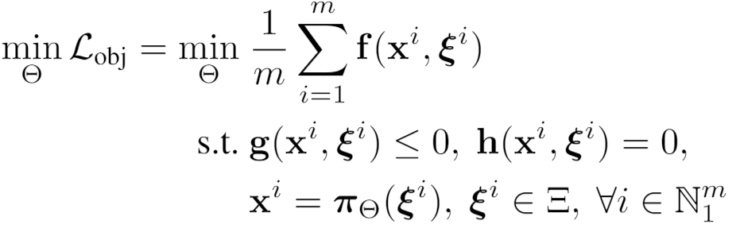
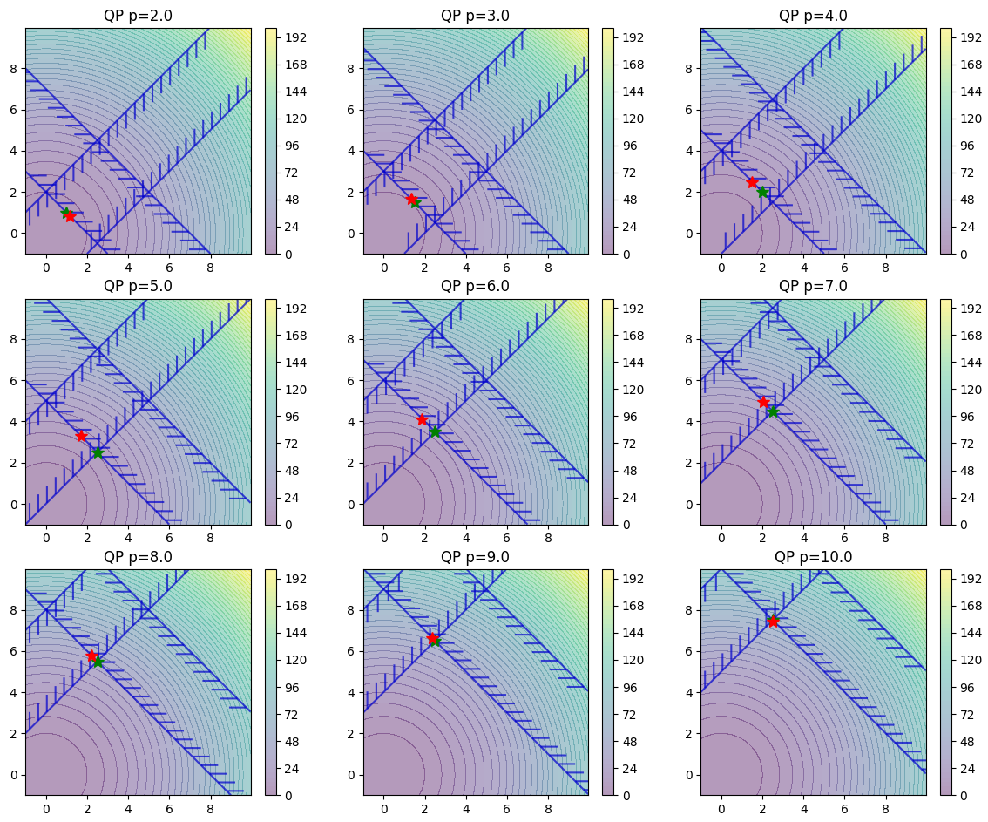
Differentiable Parametric Programming
https://github.com/pnnl/neuromancer
Data-driven solution of
parametric quadratic program
train_data,dev_data,test_data = get_dataloaders(samples)
map = nm.map(input_keys=['p’], output_keys=[‘x’,‘y’], name='map')
x = Variable(‘x')
y = Variable('y')
p1 = Variable('p') f = x ** 2 + y ** 2 obj = f.minimize(weight=Q, name='obj’) g1 = -x - y + p1 con_1 = Q_con*(g1 <= 0)
objectives = [obj]
Constraints = [con_1] components = [map] model = Problem(objectives, constraints, components) optimizer = torch.optim.AdamW(model.parameters(), lr=args.lr) trainer = Trainer(model,train_data,dev_data,test_data,optimizer)
best_model = trainer.train()

Slide 9
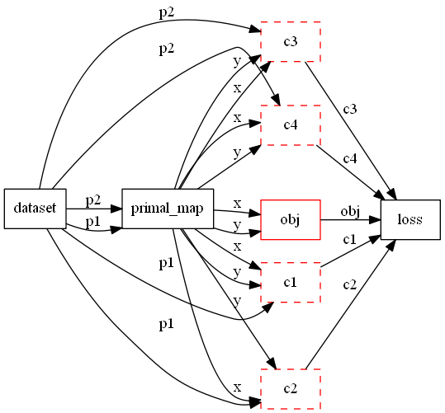
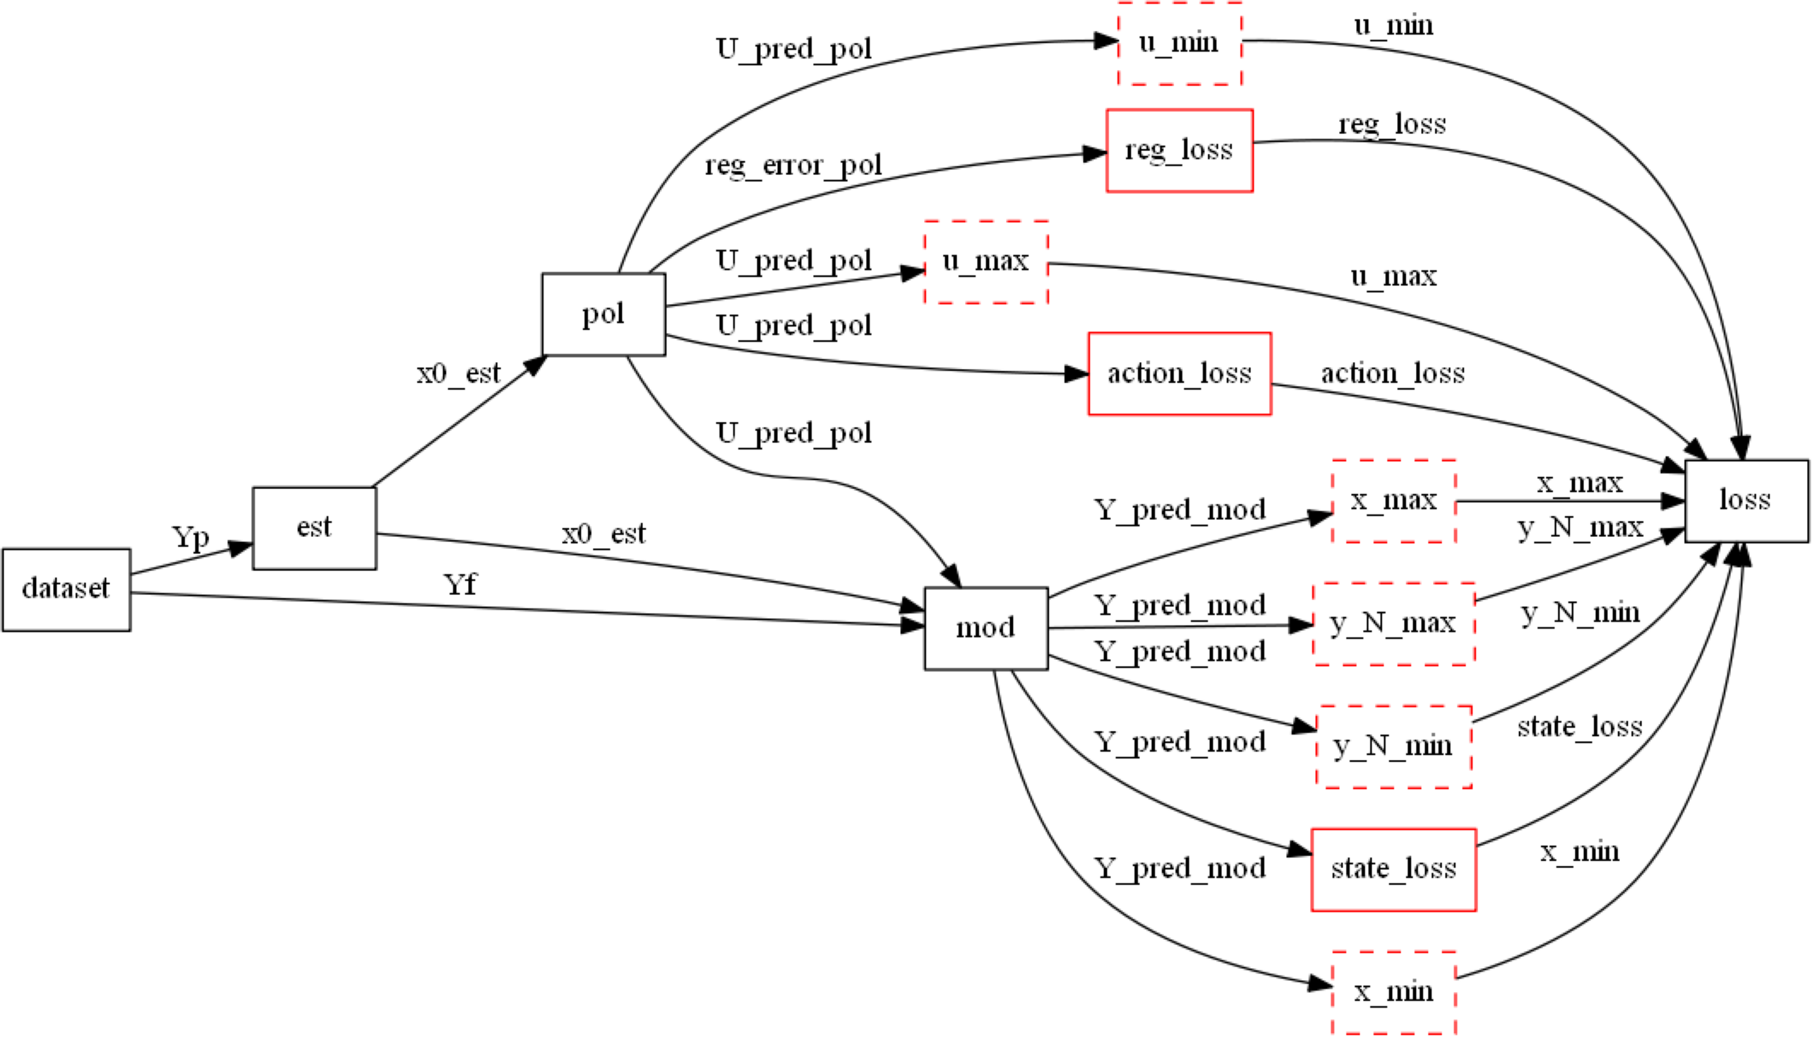
Differentiable Parametric Programming Computational Graphs in NeuroMANCER
https://github.com/pnnl/neuromancer
Multi-parametric quadratic program (mpQP)
Differentiable predictive control (DPC)

Slide 10
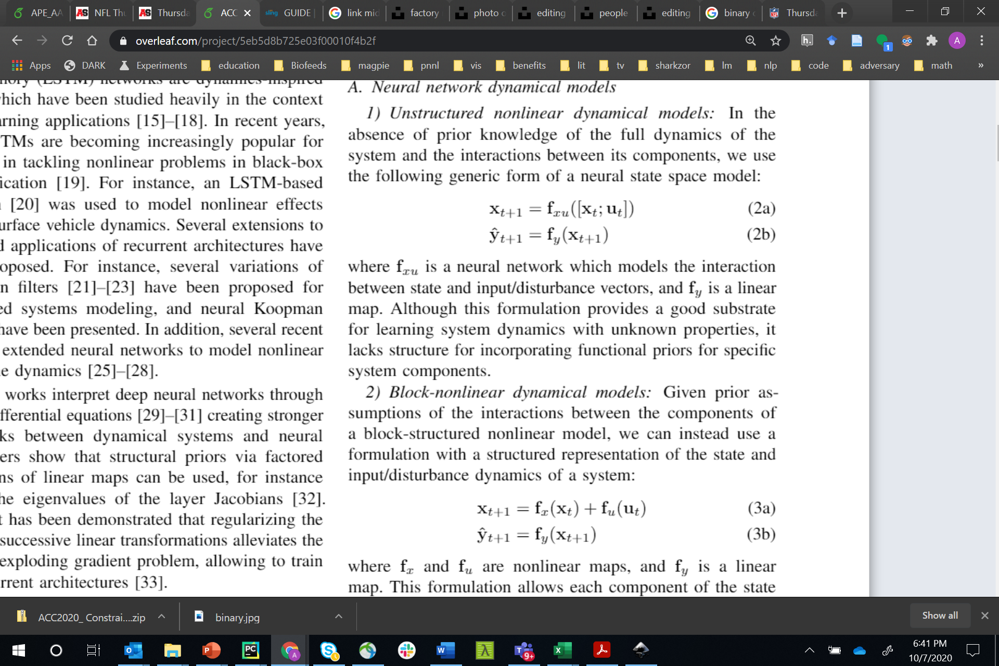
Neural State Space Models
x_{t}
f_{x}
x_{t+1}
f_{y}
x₀
+
y_{t+1}
f_{x}
f_{y}
f_{u}
f_{x}
f_{y}
+
u_{t}
f_{u}
f_{u}
f_{u} o f_{y} = I
Linear
Hammerstein
Koopman
x_{t}
x_{t+1}
y_{t+1}
f_{x}
f_{y}
f_{x}
f_{y}
f_{xu}
f_{y}
+
+
u_{t}
f_{u}
f_{u}
Block-Nonlinear
Unstructured
Hammerstein-Weiner
Linear map
Non-Linear map

Slide 11
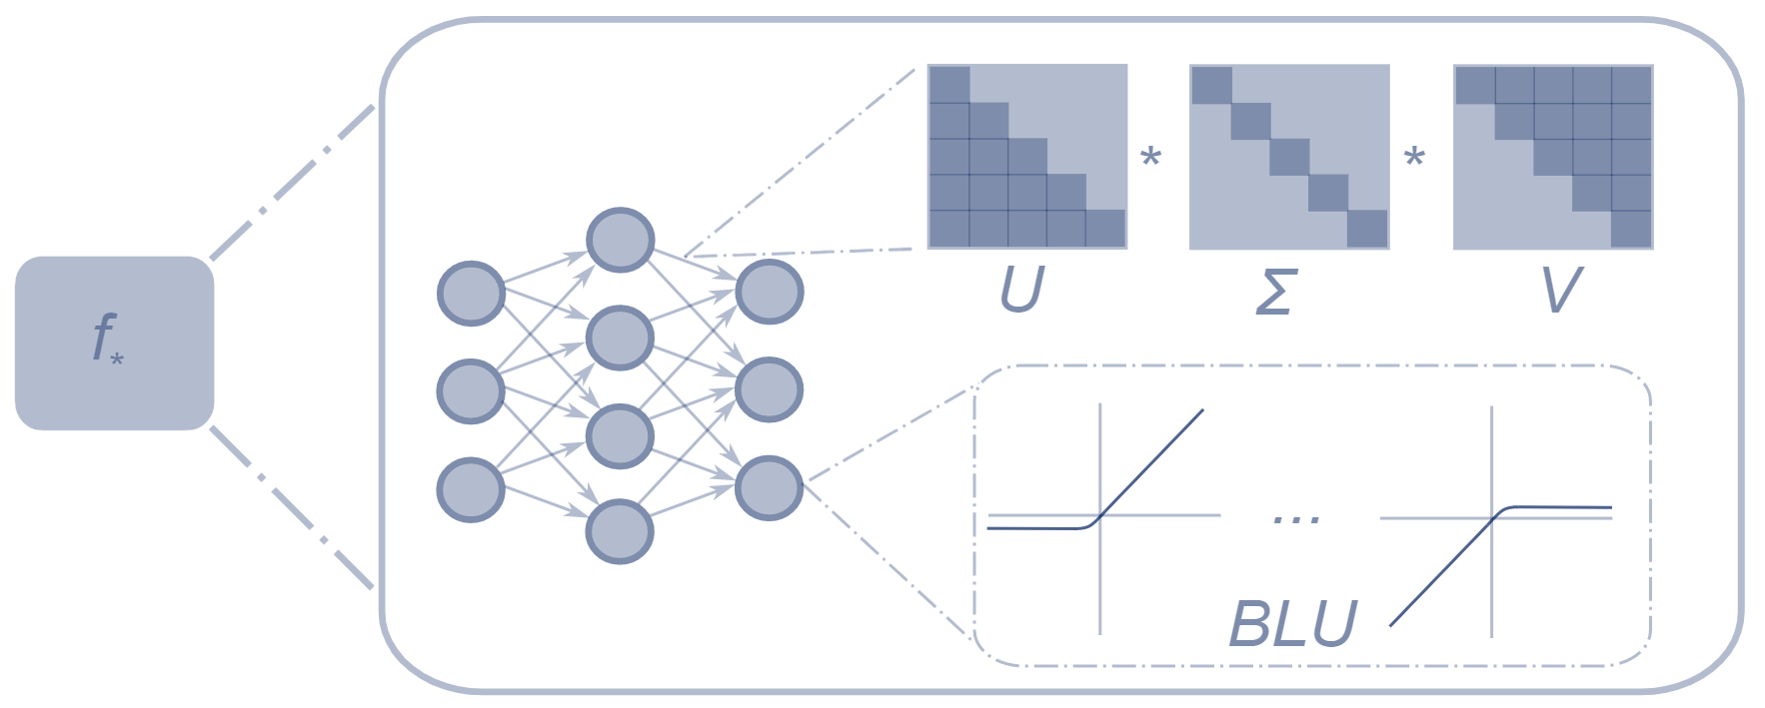
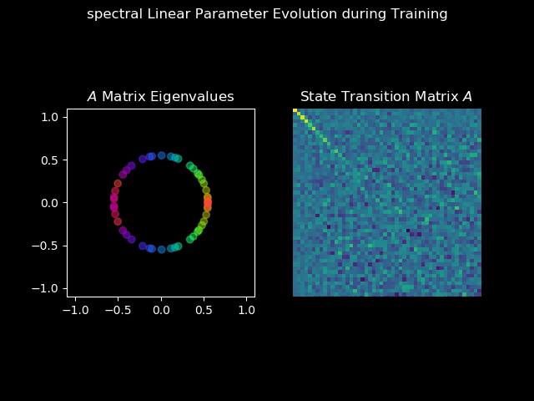
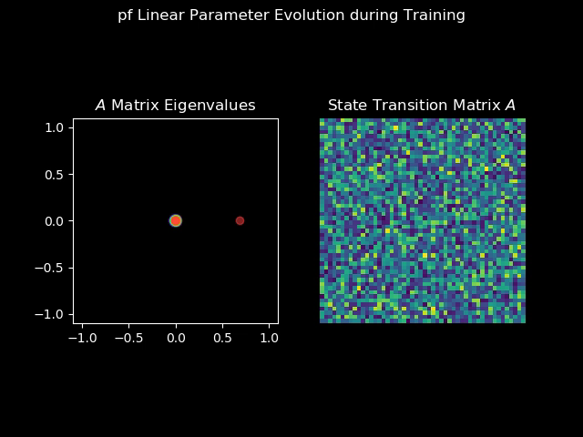
Structured Linear Maps (SLiM)
Factorizations and regularizations of linear maps with predetermined structure
Can be used to enforce sparsity or spectral properties
https://github.com/pnnl/slim
Spectral map
Perron-Frobenius map

Slide 12
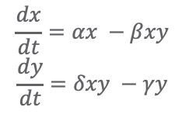
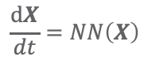
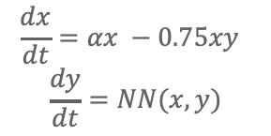
Neural Ordinary Differential Equations
Goal: provide a suite of robust methods for interpretable, data-driven time-stepping
Methods:
Learning flow maps (MLPs and RNNs) for neural ODE implicit layers
ODE solution techniques: RK45, hierarchical, higher-order, implicit, multi-step
Physically-informed models: blend expert knowledge with neural ODE construction (ongoing)
PDEs
White-box:
Gray-box:
Black Box:
$$\frac{dx}{dt}=αx −βxy$$
$$\frac{dy}{dt}=δxy −γy$$
$$\frac{dx}{dt}=αx −0.75xy$$
$$\frac{dy}{dt}=NN(x,y)$$
$$\frac{dX}{dt}=NN\left(X\right)$$
Applications: Grid infrastructure, molecular dynamics, damped-driven systems, seismic responses, building thermal dynamics, UAVs, etc.

Slide 13
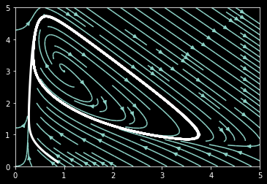
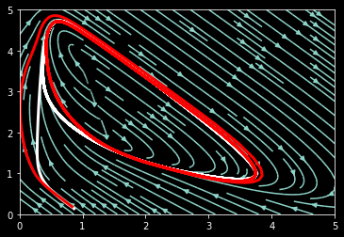
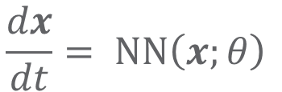
Neural ODE with Runge-Kutta Integration
Data: Brusselator oscillator
$$\frac{dx}{dt}= NN\left(x;θ\right)$$
Black-box neural ODE*:
Ground-truth limit cycle
*NODE architecture is 2x10 MLP with Leaky ReLU activation.
Red: model limit cycle

Slide 14
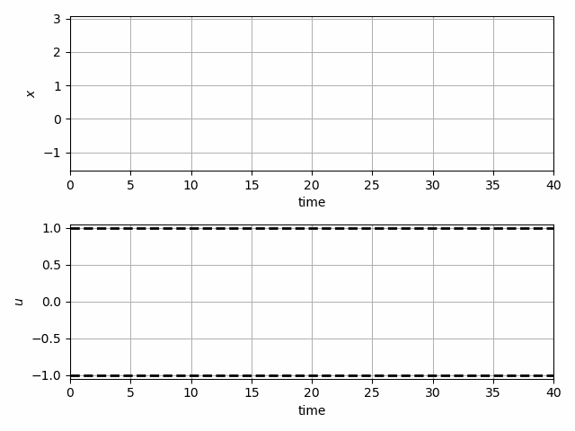
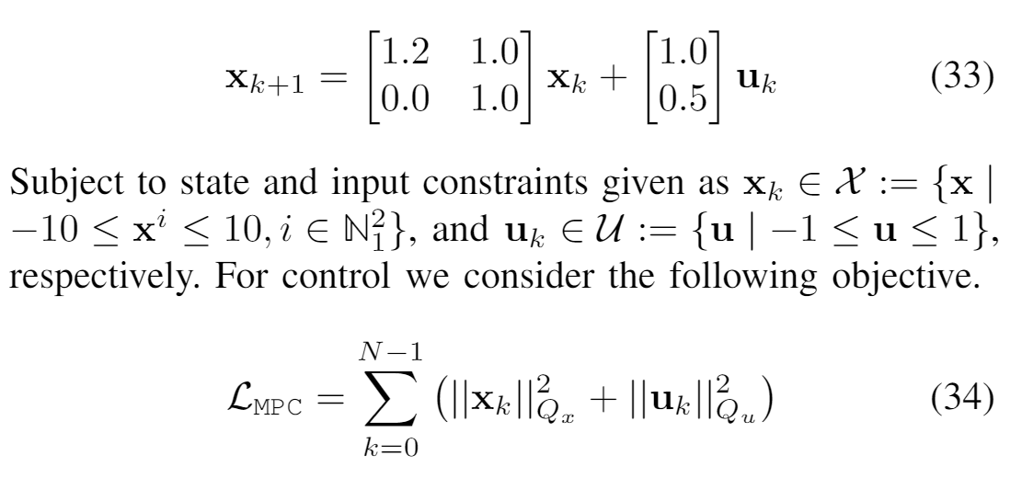
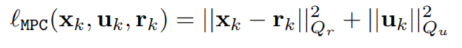
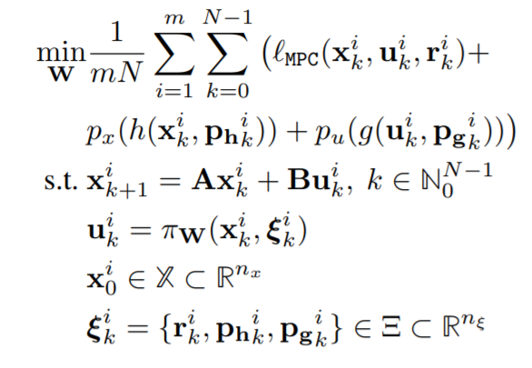
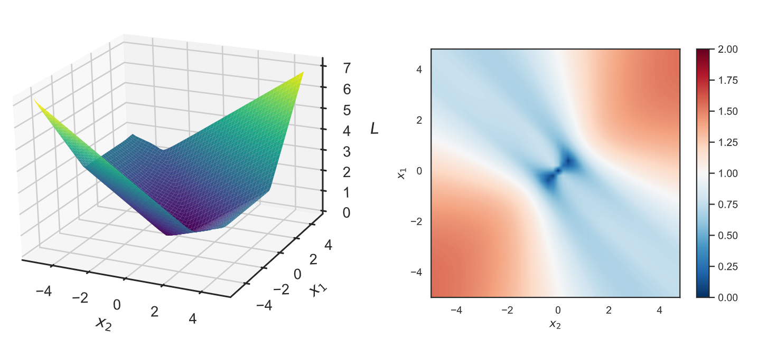
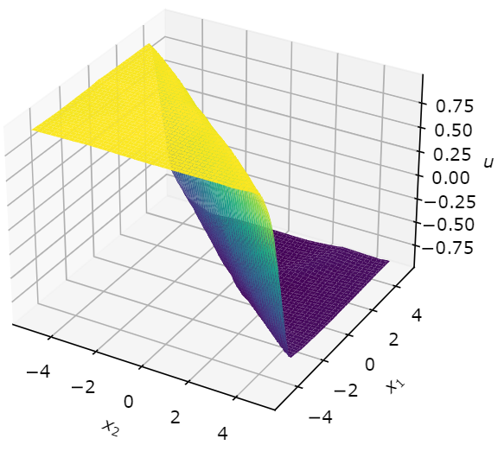
Learning to Stabilize Unstable System with Differentiable Predictive Control
Problem setup:
DPC formulation:
Jan Drgona, Aaron Tuor, Draguna Vrabie, Learning Constrained Adaptive Differentiable Predictive Control Policies With Guarantees
https://arxiv.org/abs/2004.11184

Slide 15
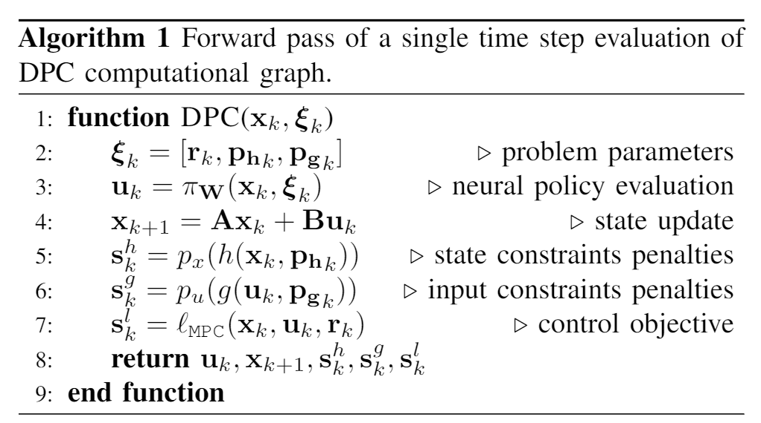
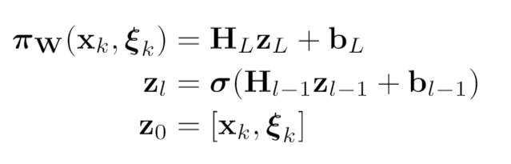
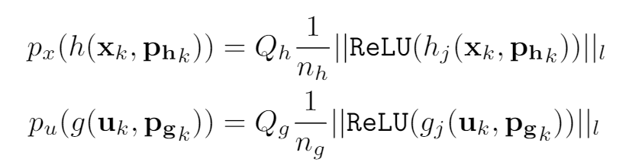
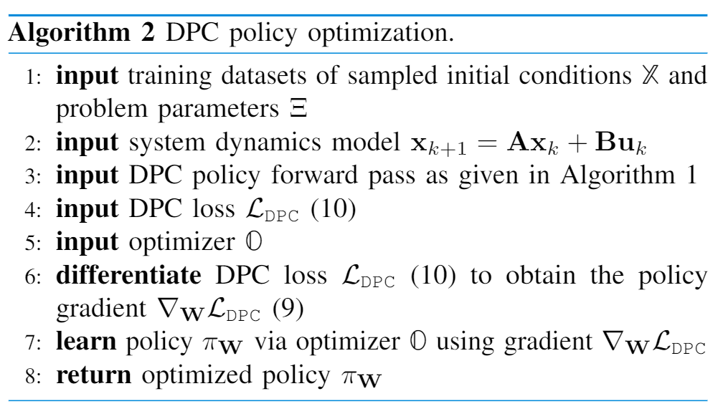
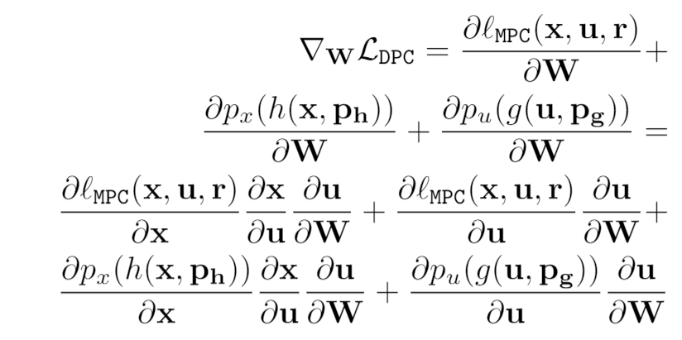
DPC Policy Gradients and Optimization
Policy
Reward function
Constraints
penalties
Direct policy gradients

Slide 16
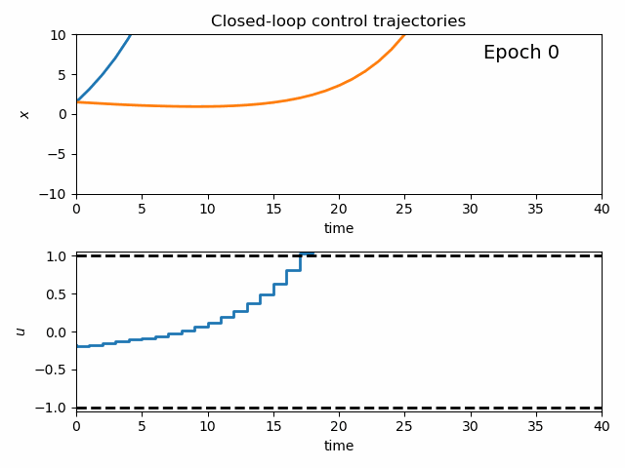
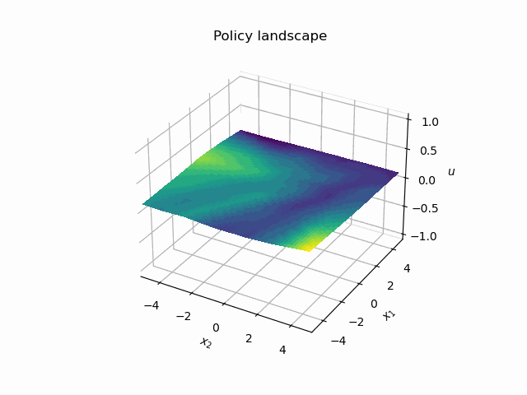
Dynamics of DPC Control Policy Learning
1341 learning parameters, 48.2 seconds offline training time on a CPU with 200 epochs.

Slide 17
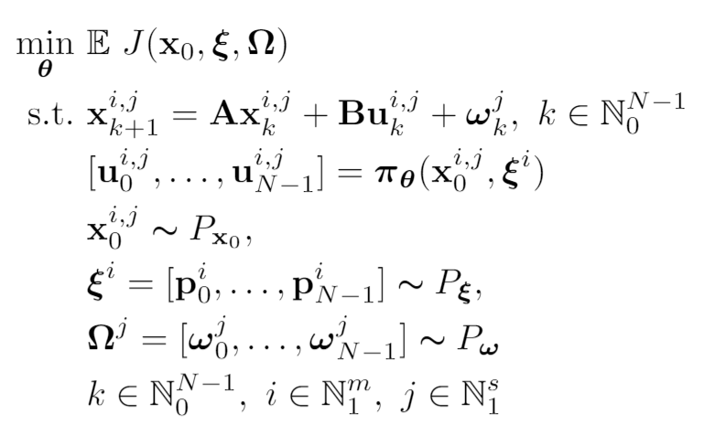
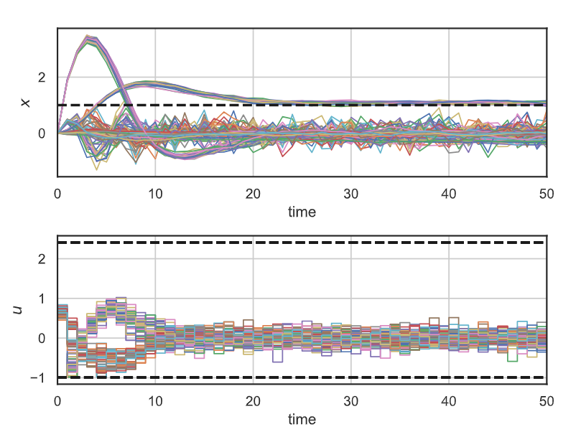
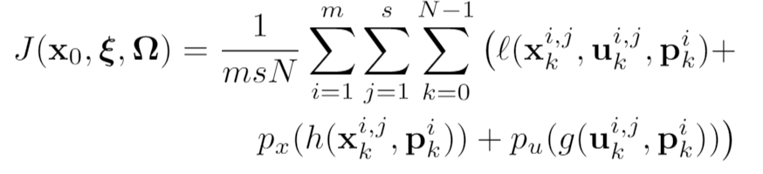
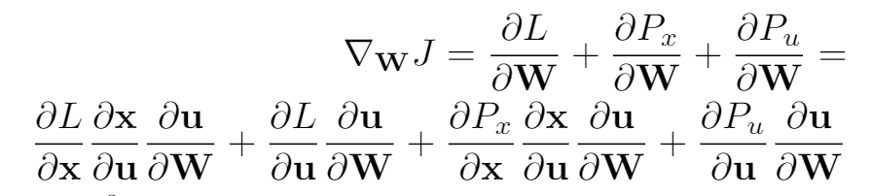
Stochastic Parametric Differentiable Predictive Control
Jan Drgona, Sayak Mukherjee, Aaron Tuor, Mahantesh Halappanavar, Draguna Vrabie, Learning Stochastic Parametric Differentiable Predictive Control Policies, under review for IFAC ROCOND 2022

Slide 18
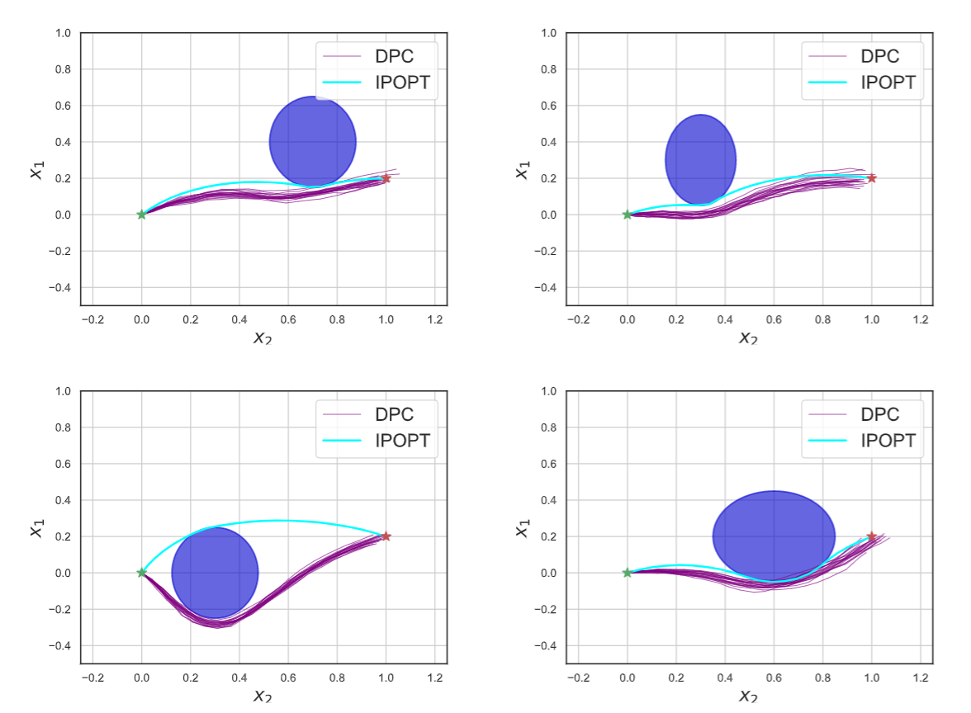
Stochastic Parametric Differentiable Predictive Control
Jan Drgona, Sayak Mukherjee, Aaron Tuor, Mahantesh Halappanavar, Draguna Vrabie, Learning Stochastic Parametric Differentiable Predictive Control Policies, under review for IFAC ROCOND 2022

Slide 19

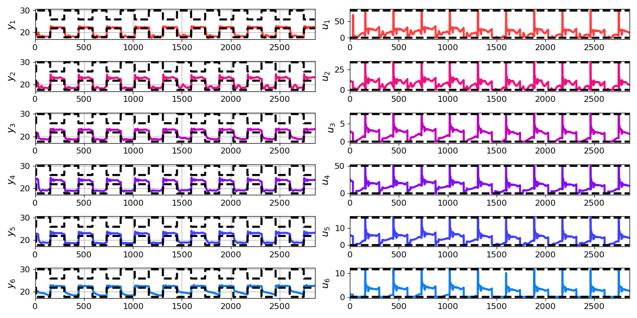
Economic Differentiable Predictive Control of Building Energy System
Neural state space dynamics model
MLP control policy architecture
Results
Handling multi-input multi-output nonlinear dynamics
Dynamic economic control objective
Parametric constraints
Jan Drgona, Aaron Tuor, Elliott Skomski, Soumya Vasisht, Draguna Vrabie, Deep Learning Explicit Differentiable Predictive Control Laws for Buildings, IFAC NMPC 2021

Slide 20
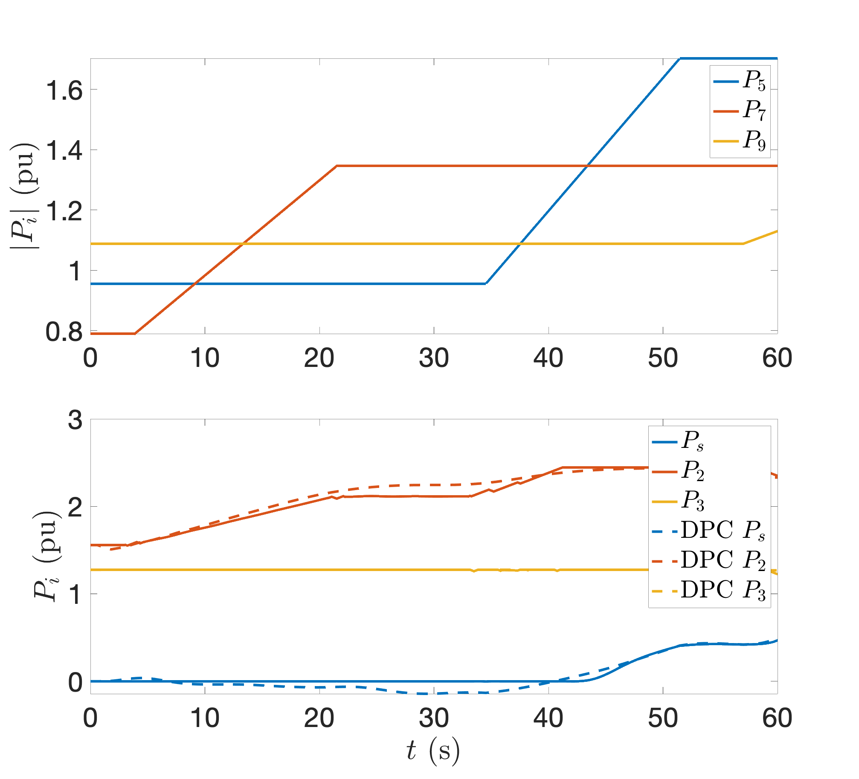
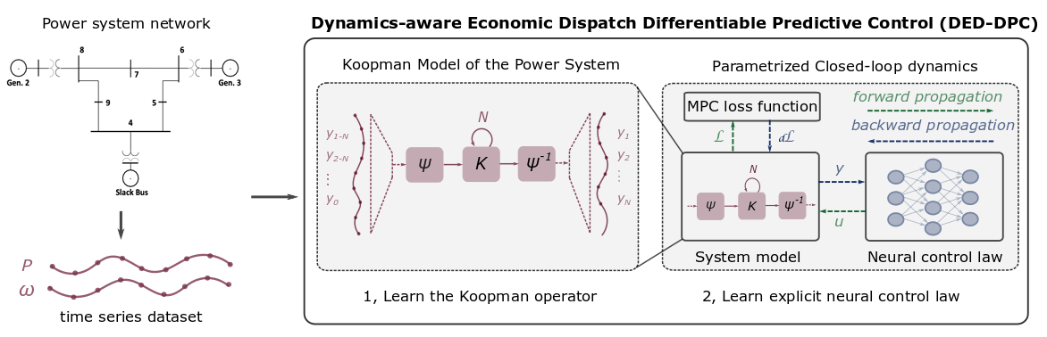
Dynamics-Aware Economic Redispatch via Differentiable Predictive Control
Problem: Current redispatch processes do not incorporate system stability concerns. Incorporating stability in redispatch is too complex and/or time-consuming
Solution: Machine-learning based dynamics-aware redispatch. Learn system dynamics for faster assessment.
KO dynamics model
CNN control policy framework
Results
5 orders of magnitude speed-up
Minimal loss in solution quality
Ethan King, Ján Drgoňa, Aaron Tuor, Shrirang Abhyankar, Craig Bakker, Arnab Bhattacharya, Draguna Vrabie, Koopman-based Differentiable Predictive Control for the Dynamics-Aware Economic Dispatch Problem, The 2022 American Control Conference (accepted)
Notes:
Add waveform figure as a result – copy from previous slide replace discretize linearize with one block as iterative method

Slide 21
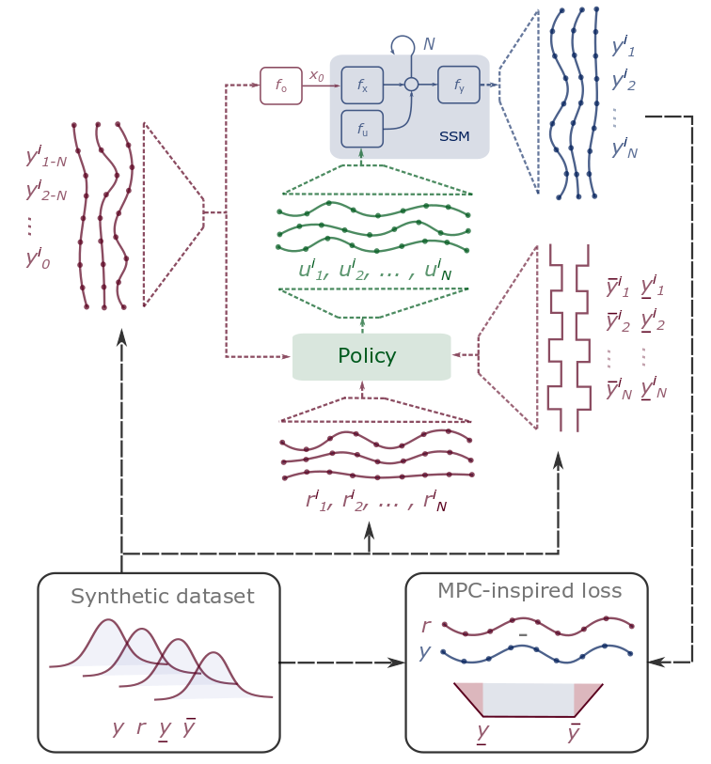
DPC Wrap Up
Differentiable Predictive Control
Differentiable system models
Explicit control policies
State and input constraints
Embedded implementation
Theoretical connection with MPC
Open-source Code
Neuromancer software package
https://github.com/pnnl/neuromancer
Structured linear maps in Pytorch
https://pnnl.github.io/slim/
Jan Drgona, et al., Differentiable Predictive Control: An MPC Alternative for Unknown Nonlinear Systems using Constrained Deep Learning https://arxiv.org/abs/2011.03699
Jan Drgona, Aaron Tuor, Draguna Vrabie, Constrained Physics-Informed Deep Learning for Stable System Identification and Control of Unknown Linear Systems https://arxiv.org/abs/2004.11184

Slide 22
Research Opportunities via Differentiable Optimization
Safe model-based control via neural Lyapunov functions (ongoing)
Nonlinear system identification via neural state space models, neural ODEs
Control for partially observable systems via model-based state estimation
UQ for system identification and model-based control by leveraging robust and stochastic MPC ideas
Inverse RL
Systematic review and empirical comparison of MPC and RL on benchmarks

Slide 23
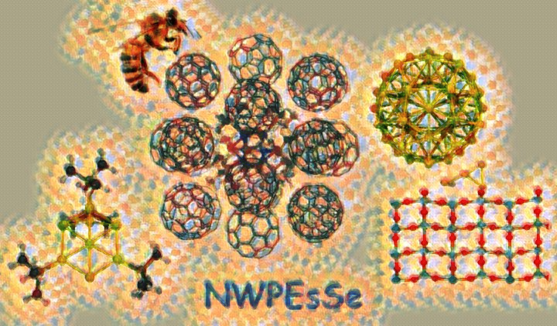


NeuroMANCER Motivation and Aims
Simulations are crucial for many areas of decision-making and scientific discovery
Need: Improve computational efficiency and scalability for heterogenous scientific simulations
Objectives:
Domain-agnostic software package and new modeling paradigm
Scientific computing frameworks enhanced by data science
Algorithmic speedups enhanced with HPC
Applications: Simulation, optimization, and control of dynamical systems (ODE, PDE, DAE, Hybrid systems)

Slide 24


NeuroMANCER framework
What
Open-source scientific machine learning (SciML) framework in Python for integrating deep learning, constrained optimization, and physics-based modeling
Current applications
Power systems (DMC initiative)
Molecular dynamics (DMC initiative)
Building control (CRADA BTO)
Underwater autonomous vehicle (MARS initiative)
Approaches
Physics-informed, data-driven modeling and control
Parametric programming (Sensitivity Analysis)
Differentiable programming (Automatic Differentiation)
https://github.com/pnnl/neuromancer

Slide 25


NeuroMANCER Supported Problems
Differentiable parametric programming (DPP)
Linear, Quadratic, Nonlinear programs (LP, QP, NLP)
Mixed integer nonlinear programming (MINLP) (ongoing)
Physics-informed system identification
Neural state space models (NSSM)
Neural ordinary differential equations (NODE)
Differentiable predictive control (DPC)
Constrained parametric optimal control problems
Constrained ML
Classical deep learning (RNN, MLP, ResNet)
Graph neural nets (GNNs)
https://github.com/pnnl/neuromancer/tree/master/examples

Slide 26






Conclusion
NeuroMANCER
Differentiable programming
Parametric programming
Constrained optimization
Dynamical modeling and control
Ongoing work
Parametric solvers (pIPOPT, etc.)
Graph neural networks (GNNs)
Mixed-integer programs (MIP)
Uncertainty Quantification (UQ)
Long-Term Vision
Causal discovery, dynamical coupling, sensitivity, structure, and stability analysis, machine reasoning
Solving large-scale non-convex parametric constrained optimization problems
https://github.com/pnnl/neuromancer
https://github.com/pnnl/slim

